Slide 1
Healthcare Payers
AI orchestration for health plans, Medicare Advantage, Medicaid MCOs & self-insured employers — powered by the #1 iPaaS
Notes:
Slide Structure:
Slide 1: Title + Hook
Title: "Accelerating Banking Operations with AI & Automation"
Subtitle: [Prospect Bank Name] + Workato
Visual: Banking imagery (not stock handshake clichés)
Script: "Thanks for the time today. I want to share how leading banks are using automation to transform loan processing, compliance, and customer experience..."
Slide 2: The Challenge (Industry-Specific)
Headline: "Banks Are Caught Between Growth Pressure and Operational Complexity"
Content (3 visual stats):
📉 "Customer expectations: Same-day loan decisions"
⚠️ "Reality: 7-14 day processing times, 23% abandonment"
💰 "Impact: $4.2M in lost revenue annually for mid-size banks"
Visual: Icons + brief stats (not bullet points)
Script: "What we're hearing from banks like yours: customers expect instant decisions, but manual processes across Salesforce, your LOS, and core banking create bottlenecks..."
Slide 3: The Workato Approach (Solution Framework)
Headline: "Orchestrate Data, Systems & AI Across Your Banking Operations"
Content (3 capability pillars with icons):
🔗 Connect Everything: 1200+ connectors (Salesforce, nCino, Temenos, SAGE, Guidewire)
🤖 Add Intelligence: AI agents for underwriting, fraud checks, compliance
⚡ Empower Teams: Business users build workflows, not just IT
Visual: Simple architecture diagram showing systems flowing through Workato
Script: "Workato sits in the middle, orchestrating data between your CRM, loan origination, core banking, and compliance systems. Your business teams can build and modify these workflows without waiting on IT..."
Slide 4: Proof (Customer Success Snapshot)
Headline: "[Similar Bank/Credit Union] Achieved These Results in 6 Months"
Content (Before/After metrics):
Loan processing: 7 days → 4 hours ⚡
Cost per loan: $450 → $180 💰
Compliance violations: 12 → 0 ✅
FTE redeployed: 15 employees to customer service 👥
Visual: Customer logo + headshot + quote (if approved)
Quote: "Workato gave us the agility to launch new products without rip-and-replace." - VP Digital Banking
Script: "Here's a credit union similar to you in size and tech stack. They were struggling with the same loan processing bottleneck. After implementing Workato..."
Slide 5: Next Steps (Clear CTA)
Headline: "Let's Explore What's Possible for [Prospect Name]"
Content:
✓ Discovery Workshop (2 hours): Map your loan origination process
✓ Value Assessment (1 week): Quantify your automation opportunity
✓ Pilot Use Case (30 days): Prove ROI with one workflow
Visual: Simple timeline graphic
CTA: "Can we schedule a 2-hour workshop with your lending and IT teams?"
Script: "I'd love to do a deeper dive on your specific environment. We typically start with a discovery workshop where we map your current loan process, identify automation opportunities, and build a business case..."
Customization Zones for Partners/Sellers:
Slide 1: Add partner logo (if GSI co-sell)
Slide 2: Swap industry stats (use different challenge if prospect cares more about compliance than loans)
Slide 4: Change customer proof to closest match (community bank vs. regional bank vs. credit union)

Slide 2


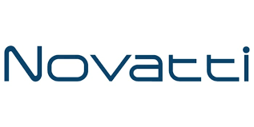

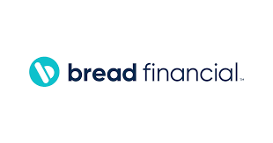
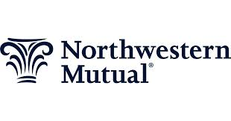
Accounts opened.
Loans approved.
Customers answered.
Work done!
Notes:
Top vertical segment messaging

Slide 3
Members want answers. CMS wants compliance. Costs keep rising.
Enterprise Agility: CMS has mandated FHIR-based prior authorization APIs — every health plan must build or integrate compliant PA workflows by regulatory deadline. Workato connects HealthEdge, FACETS, QNXT, and Availity to a CMS-compliant FHIR PA workflow in weeks, not the multi-year program most plans are projecting. Risk Reduction: Average healthcare data breach cost = $9.77M (IBM) — the highest of any regulated industry. HIPAA BAA available with every Workato deployment. SOC 2 Type II certified. Human-in-the-loop approvals for PA denials and claim exceptions. Every AI agent action carries a complete audit trail for OCR audits and CMS examinations. Efficiency & OrCA: Administrative costs represent 25-30% of US health insurance spending (CMS). CAQH benchmark: manual prior auth costs $11 per request; automated costs under $2. Open enrollment creates 10-50x normal volume spikes. Workato’s OrCA autoscales without infrastructure provisioning. Revenue Growth: Each 0.5-star improvement in Medicare Advantage Star Ratings can represent $100M+ in CMS quality bonus payments for large plans. Workato’s Care Gap Genie closes HEDIS gaps in real time. Member Support Genie improves CAHPS scores while cutting contact center cost from $12 to under $1 per interaction.
$11 per manual prior auth request (CAQH)vs. under $2 automated. Every PA interaction is a cost decision. And a CMS mandate compliance decision.
Notes:
Align with Value drivers of WSS.
—--------
Discover time - what are you needed to solve??

Slide 4
Built for the health plan technology stack
Enterprise MCP Server Templates
AI Genies
Prior Authorization Genie (CMS FHIR) | Claims Auto-Adjudication Genie | Care Gap & HEDIS Genie | Eligibility Genie | Member Support Genie (HIPAA) | Provider Credentialing Genie
Claims & Benefits Connectors
HealthEdge HealthRules Payor | FACETS / TriZetto (Cognizant) | QNXT | Inovalon | Availity | Change Healthcare (Optum) | CAQH ProView | Acqueon | Salesforce Health Cloud | Workday | Oracle | SAP | Snowflake | AWS Redshift | Databricks | Express Scripts / Evernorth (PBM) | OptumRx | Amazon DynamoDB | AWS Bedrock
Notes:
How do we fit into the Banking ecosystem.
Connectors - Orchestration out

Slide 5
Four priorities. Measurable outcomes.
Claims Auto-Adjudication (80%+ STP Target)
Prior Authorization Automation (CMS FHIR Mandate)
Member Onboarding & Eligibility Activation
Care Gap Closure & Star Rating Improvement

Slide 6
Use Case: Prior Authorization Automation
Current: PA request received → manual clinical criteria review → 3-5 business day turnaround → fax/phone notification → $11 per request (CAQH). Target: PA request → automated clinical criteria check → auto-approve routine / human review exception → FHIR API status update → same-day decision → under $2 per request. CMS mandate: compliant from deployment.

Slide 7
Why Workato for Healthcare Payers

Slide 8
Health plans running on Workato
Healthfirst
NYC nonprofit managed care organization — member services at scale $733K ARR • 575 active recipes • 3+ business units • Acqueon + Amazon DynamoDB + Workbot + Event Streams + APIM + WFA + CICD for GitHub • Cloud-native autoscaling handles open enrollment surges without infrastructure provisioning • Workato’s largest health payer customer
HealthEquity
HSA/FSA member benefits administration automated $99K ARR • Salesforce Data Cloud + SFMC + Azure Auth + Event Streams + Data Integration • Member communication, eligibility, and benefits administration all orchestrated • Real-time member data across HSA, FSA, and HRA accounts
Oscar Health
Digital-first health plan: member identity and engagement automated $92K ARR • Okta (identity) + Salesforce (CRM) + Google Workspace + Workbot • Member provisioning, access management, and internal workflows automated • Digital-first member experience built on Workato orchestration
Notes:
Links to each of the customer reference packages.

Slide 9
Healthfirst: 575 Recipes. 3+ BUs. Health Payer at Scale.
Industry: Nonprofit Managed Care (Medicare, Medicaid, Commercial), New York | $733K ARR | 575 active recipes | 3+ business units Challenge: NYC nonprofit managed care organization needed to connect claims, member services, care management, and IT operations across 3+ business units — with open enrollment volume spikes of 10-50x normal capacity demands. Outcomes: $733K ARR — Workato’s largest health payer customer • 575 active recipes across member services, claims, IT, and operations • Acqueon (member outreach) + Amazon DynamoDB + Workbot + Event Streams + APIM + WFA all active • CICD for GitHub automated • Cloud-native autoscaling handles open enrollment surges without provisioning additional infrastructure • Member services AI agents running with governed access to claims and eligibility data. Workato how: OrCA handles open enrollment volume spikes automatically. Enterprise MCP connects member services AI agents to live claims and eligibility data. Workbot enables internal team self-service. SCALE differentiator: OrCA + Cloud Native Autoscaling.

Slide 10
HealthEquity: HSA/FSA Benefits Administration Automated
Industry: Health Savings Account (HSA), FSA & HRA Administration | $99K ARR Challenge: HealthEquity needed to connect Salesforce Data Cloud, Salesforce Marketing Cloud, and Azure Auth to automate member communication, eligibility updates, and benefits administration across HSA, FSA, and HRA accounts. Outcomes: $99K ARR • Salesforce Data Cloud + SFMC + Azure Auth + Event Streams + Data Integration all active • Member communication triggered automatically by eligibility events • Real-time data flow between CRM, marketing, and benefits systems • Open enrollment campaigns triggered by enrollment data in real time. Workato how: Azure Auth (identity) → SF Data Cloud (member data) → SFMC (member communication campaigns) → Event Streams (real-time triggers). Data Integration pipelines keep member data current across all systems. SPEED differentiator: Fast Build + Salesforce Health Cloud connectivity.

Slide 11
Bind Benefits: Member Engagement & Quality Improvement Automated
Industry: Health Plan Innovation (Flexible Benefit Design), USA | $88K ARR Challenge: Innovative health plan with a consumer-first model needed to automate member engagement, wellness program participation, and quality improvement outreach across Qualtrics, ON24, Rally, Salesforce, and Marketo. Outcomes: $88K ARR • Qualtrics (member satisfaction) + ON24 (member education) + Rally (wellness programs) + Salesforce + Marketo all connected • CAHPS member satisfaction surveys automated • Wellness program participation campaigns triggered by member data • Quality improvement outreach aligned to HEDIS measure improvement. Workato how: Member data → Qualtrics survey trigger → ON24 education webinar enrollment → Rally wellness incentive → Marketo follow-up campaign. POWER differentiator: Enterprise MCP + HIPAA BAA for member data handling. Revenue Growth differentiator: CAHPS score improvement → Star Rating improvement → CMS quality bonus.

Slide 12









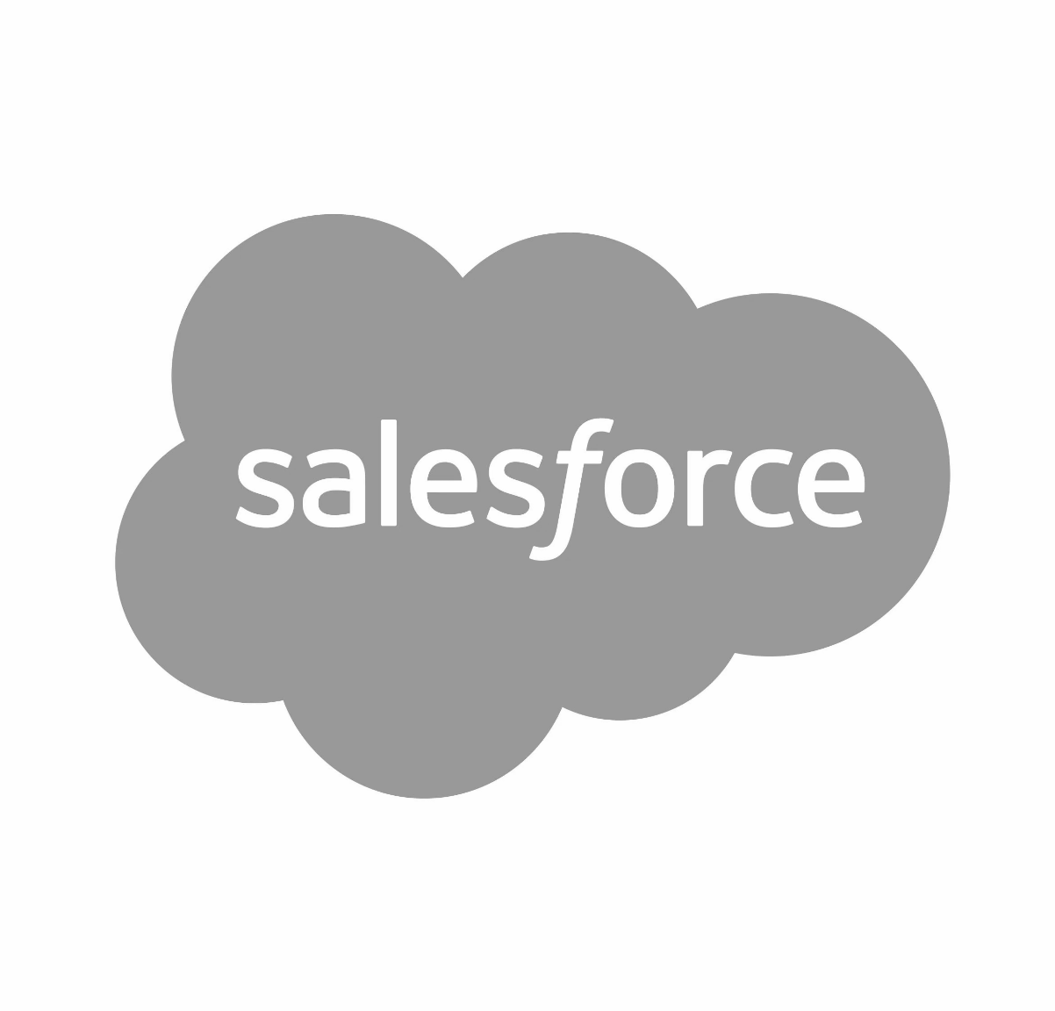



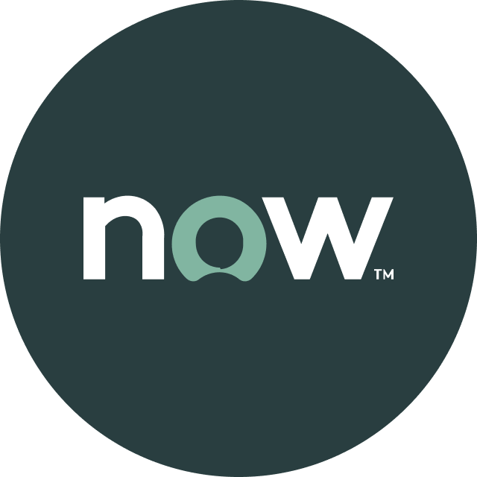


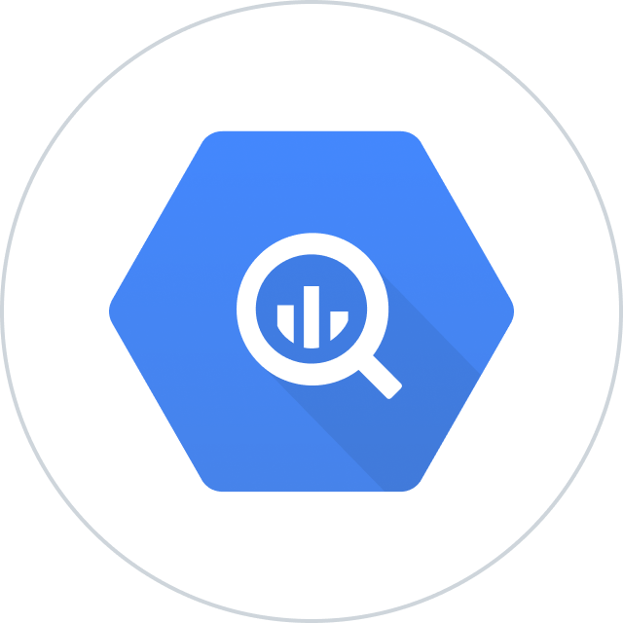


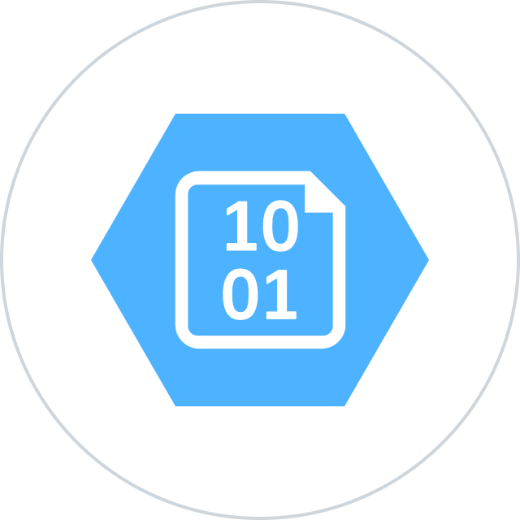


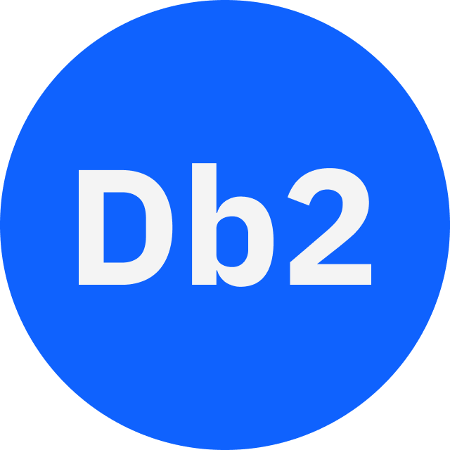





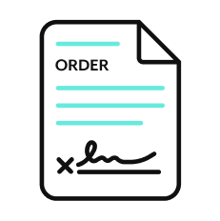

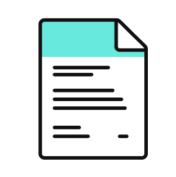





Orchestration for the Agentic Era—Powered by the #1 iPaaS.
I
Build agents with us
Go faster with Enterprise Skill packs and Workato Genies
W O R K A T O E N T E R P R I S E M C P
P L A T F O R M A G E N T S
E N T E R P R I S E S K I L L S
T R U S T
MCP Gateway
Observability
New simpler graphic
Solution Architect (AIRO™)
Skills Builder
MCP Composition
MCP Registry
MCP Proxy
Governance
O R C H E S T R A T I O N
Security
Data Scientist (Acumen)
Process Automation
Application Integration & B2B
Compliance
Data Orchestration
API Management
Explainability
Powered by iPaaS+
U N I V E R S A L C O N N E C T I V I T Y
SaaS/On-prem
Data Warehouse/ Data Lakes
Databases
LLMs
Unstructured
Traditional
Invoice
Media
Transcripts
Contracts
SFTP
Mainframe
Custom
Archives
Notes:
This is Workato ONE —Orchestration for the Agentic Era—Powered by the #1 iPaaS.
Unlike solutions that give you pieces of the puzzle, Workato ONE delivers the complete agentic enterprise:
Workato ONE One platform for data, apps, and agents
Workato GO puts enterprise search with Deep Action™ directly in every employee's hands
Workato Agentic builds and deploys production-ready agents with full enterprise context
Workato Enterprise MCP One trusted bridge for every agent to connect to applications and systems safely and securely
Workato Orchestrate powers complex workflows across teams, systems, and agents
All built on universal connectivity to 10,000+ applications and data sources
What makes this different? True Enterprise Orchestration.
Everyone talks about integration—APIs, MCP, basic workflows. But enterprise orchestration is fundamentally different. It's:
Transactionality that ensures every action completes or rolls back cleanly
In-sequence and exactly-once delivery so your financial transactions never duplicate
Runtime authentication and RBAC that enforces your security policies in real-time
PII obfuscation and data governance that maintains compliance automatically
Event-driven, batch, and real-time triggers that handle any integration pattern
Plus something no one else has: 1 million+ Enterprise Skills—pre-built, production-tested capabilities that encode your business logic, not just API calls. When an agent needs to "process a return," it doesn't just update a field—it orchestrates the entire business process across systems, with all the exception handling, approvals, and compliance checks your enterprise requires.
This unified approach enables true multi-agent orchestration. Your agents don't just connect—they inherit your enterprise's operational intelligence.

Slide 13

Thank you

Slide 14
Appendix of slides

Slide 15
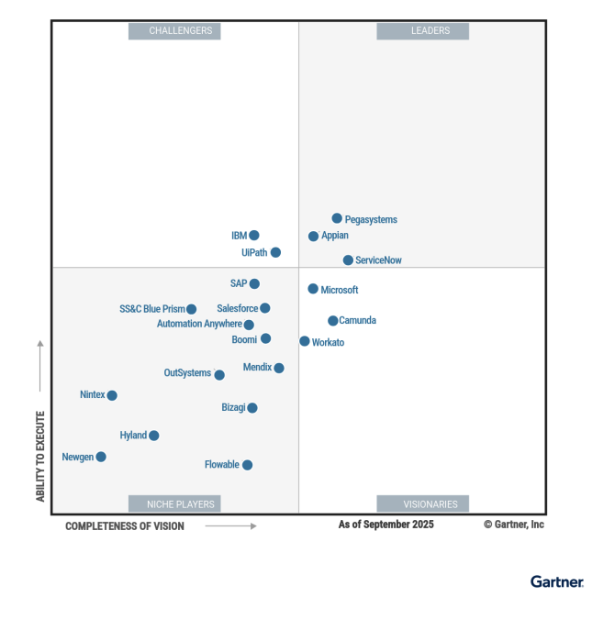
Leader in platforms and orchestration
Gartner iPaas : Leader - 7x
Visionary

